Slide 1
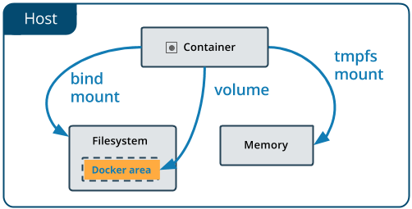
*Docker storage and networks*
#Docker storage
Docker uses storage drivers to store image layers, and to store data in the writable layer of a container.
Advantages:-
*persistent data
*Transfer data easily
*increase container performance

Slide 2
1)Docker volumes
*Docker volumes are persistent storage location for container.
*They are managed by Docker completely.
*They can easily attach and remove from container.
*Docker volumes are a widely used and useful tool for ensuring data persistence while working in containers.
*Docker volumes allow you to persist data from containers and easily share the data between multiple containers.
2)Bind mount
*Bind mount aren’t managed by Docker and are mapped to Docker system directly.
* When you use a bind mount, a file or directory on the host machine is mounted into a container.
*A bind mount allows us to mount a file system or a subset of a file system in two places at once

Slide 3
3)tmpfs mount
*This type of storage maps to the host system’s memory.
*They get removed when container attached or stopped.
*Allows you to store temporary data without effecting container efficiency.
*tmpfs mounts is not the persistent data on the disk..

Slide 4
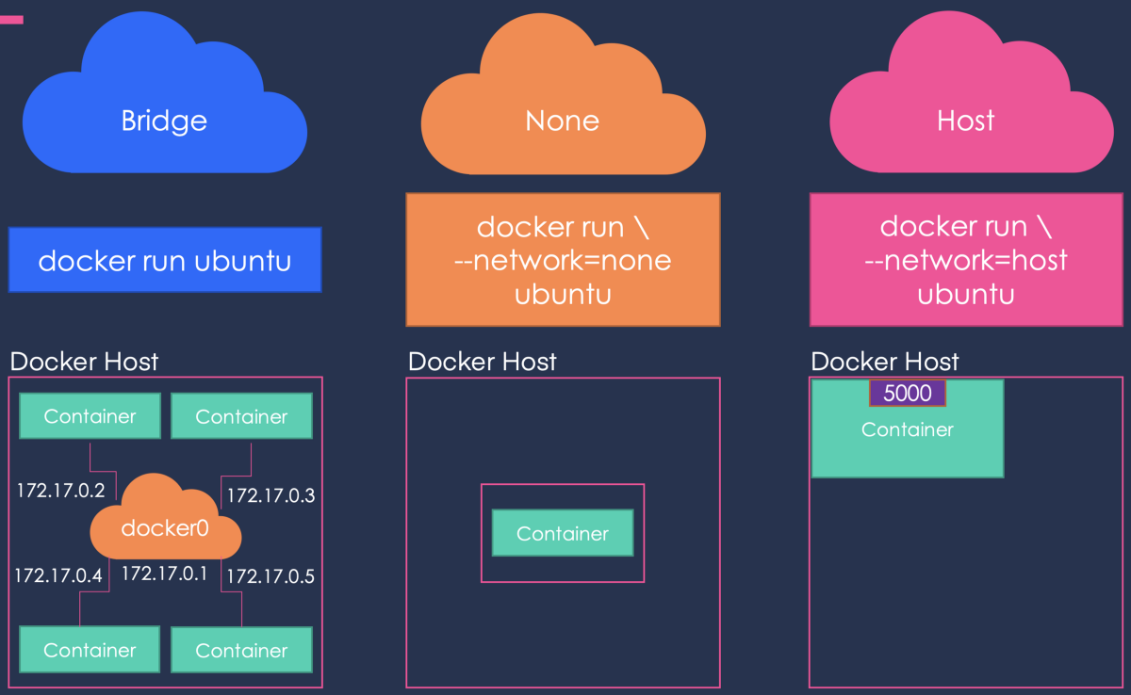
#Docker Network
*Docker Network is between one or more container.
*one of most powerful thing of Docker basically a connection container is that they can easily connected to each other. and even other software that makes very easy to isolate and manage container.

Slide 5
1)Bridge Network
* bridge network uses a software bridge which allows containers connected to the same bridge network to communicate, while providing isolation from containers which are not connected to that bridge network..
* Docker provides a pre-built default Bridge Network with Bridge driver scoped locally.
*The bridge network is the default network for new containers. This means that unless you specify a different network, all new containers will be connected to it.
2)Host Network
*Docker container that are connected to the host network share the namespace with their host i.e container share ip address of the host if don’t have its own.

Slide 6
3)Overlay Network
*This means containers present in different Docker hosts can communicate with each other
using overlay network.
*this is useful when we need to a set of Docker host to communicate with each other in a Docker swarm.
*An “overlay network” is a virtual network that runs on top of a different network.
4)None Network
*That container lacks a network interface.
*None Network: is kind of equivalent to having an interface on your machine that's not attached to anything, but we can create our own.

